Slide 1
Notes: OCT Layer Segmentation

Slide 2
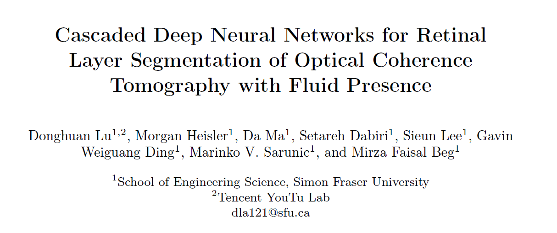

Slide 3
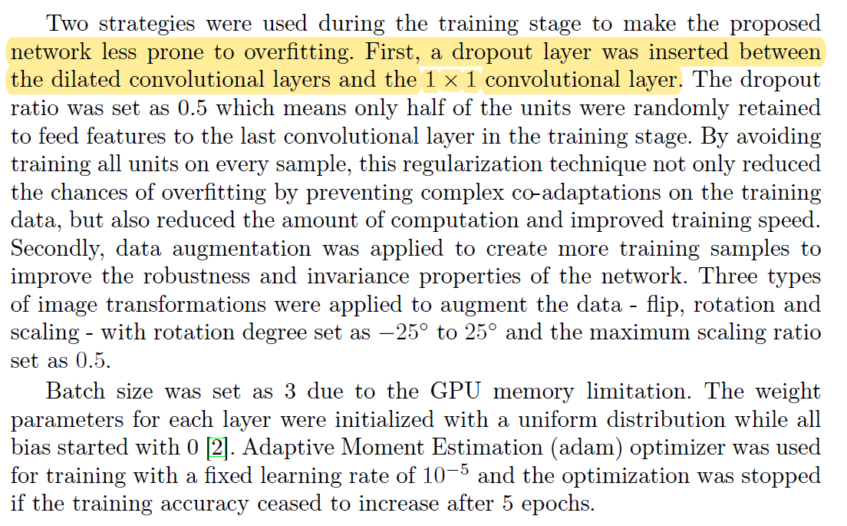

Slide 4


Solve the imbalance among different classes
The weighted dice loss:

Slide 5


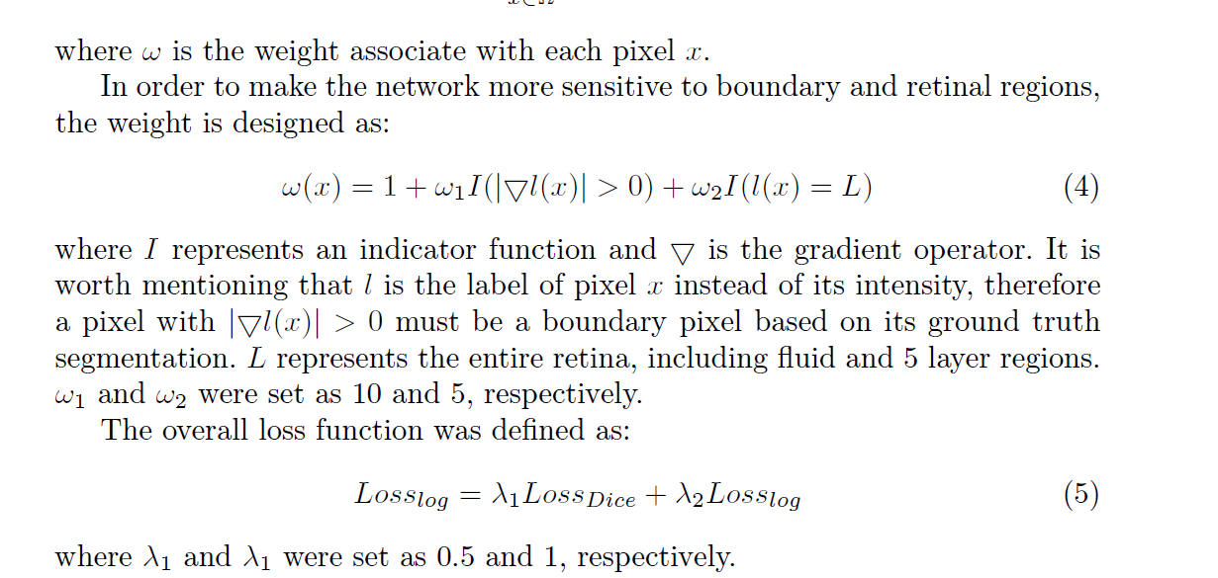
Solve the imbalance among different classes

